Slide 1
Artificial Intelligence: Past, Present & Future
A Deep Dive into AI, Its Achievements, and Future Potential
Presented by: Nikhil Prasad

Slide 2
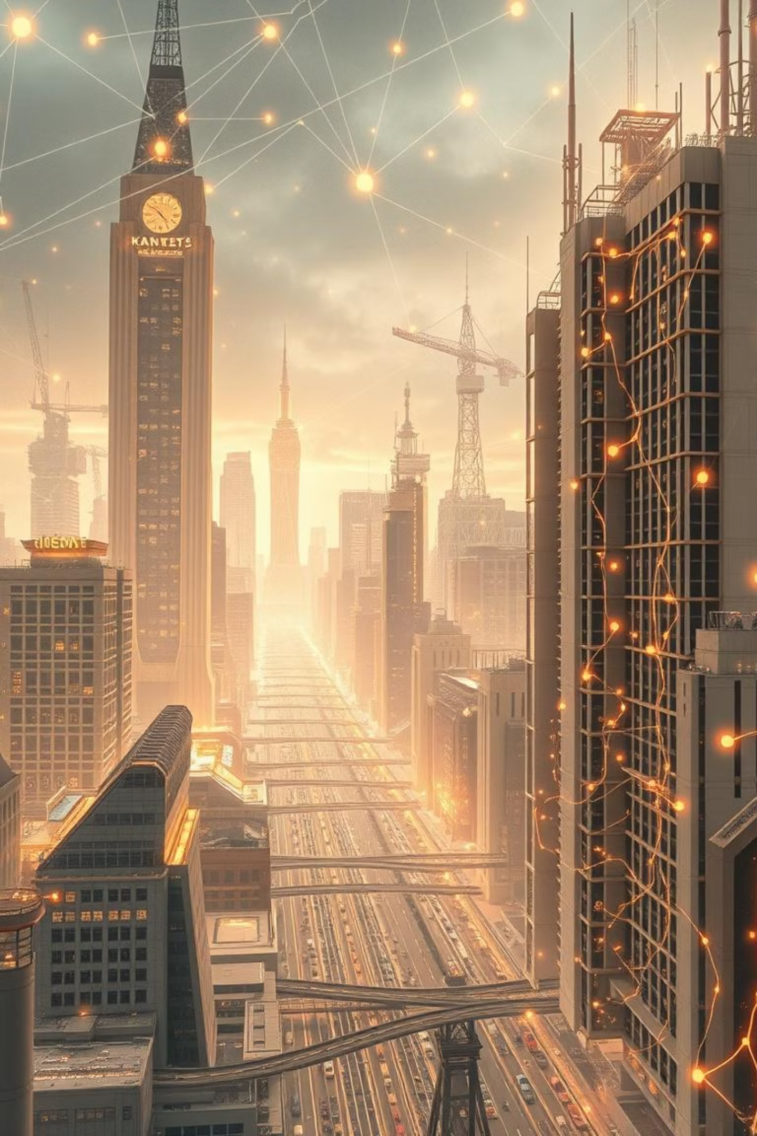
What is Artificial Intelligence?
Artificial Intelligence (AI) is a branch of computer science that aims to create systems capable of performing tasks that typically require human intelligence. These tasks include learning, problem-solving, perception, language understanding, and decision-making.
AI can be embedded in machines, programs, or robots to make them intelligent. It ranges from rule-based systems to complex neural networks that learn from data. AI is used in everyday applications like voice assistants, recommendation systems, and autonomous vehicles.

Slide 3
Types of Artificial Intelligence
1. Based on Capabilities: - Narrow AI: Also known as Weak AI, this type of AI is designed for a specific task (e.g., voice assistants, spam filters). It cannot perform tasks outside its predefined functions. - General AI: Refers to machines that can perform any intellectual task a human can. This is still a theoretical concept under development. - Super AI: Hypothetical AI that surpasses human intelligence. It could outperform humans in all cognitive tasks.
2. Based on Functionality: - Reactive Machines: Respond to inputs without storing memory (e.g., Deep Blue chess computer). - Limited Memory: Learn from historical data (e.g., self-driving cars). - Theory of Mind: Understand emotions, beliefs, and interact socially (in research). - Self-aware AI: Possess consciousness and self-awareness (not yet developed).

Slide 4
Real-World Applications of AI
Healthcare: Disease diagnosis (e.g., IBM Watson).
Finance: Fraud detection, algorithmic trading (e.g., JPMorgan COIN).
Retail: Product recommendations (e.g., Amazon, Flipkart).
Transportation: Self-driving cars (e.g., Tesla Autopilot).
Agriculture: Smart farming using drones and AI sensors.
Customer Service: Chatbots like ChatGPT, Google Bard.
Smart Assistants: Daily use – Google Assistant, Alexa, Siri.

Slide 5
How AI Benefits Society and Industries
Increased Efficiency: Automation in factories, logistics.
Better Accuracy: Reduces human error (e.g., medical AI).
Cost Savings: Reduces operational expenses.
24/7 Availability: Chatbots, AI monitoring tools.
Personalization: Recommendations (e.g., Netflix, Spotify).
Risk Reduction: Disaster response (e.g., drones in rescue missions).

Slide 6
AI Industry in 2025 – Where We Stand
Global Market: $305 billion by 2025 (Statista).
Key Players: Google, OpenAI, NVIDIA, Microsoft, Amazon.
Growth Areas: Generative AI, AI chips, Robotics.
Business Adoption: 70%+ companies investing in AI.
AI Startups: 12,000+ globally; India is a fast-growing hub.
Jobs: High demand for AI engineers, data scientists.

Slide 7
History of AI
1950: Alan Turing proposes the Turing Test.
1956: 'AI' coined at Dartmouth Conference.
1980s: Rise of expert systems (e.g., XCON).
1997: IBM’s Deep Blue beats Kasparov.
2011: IBM Watson wins Jeopardy!.
2016: AlphaGo defeats Go champion Lee Sedol.
2022-2025: Rise of Generative AI (ChatGPT, Sora, Gemini).

Slide 8
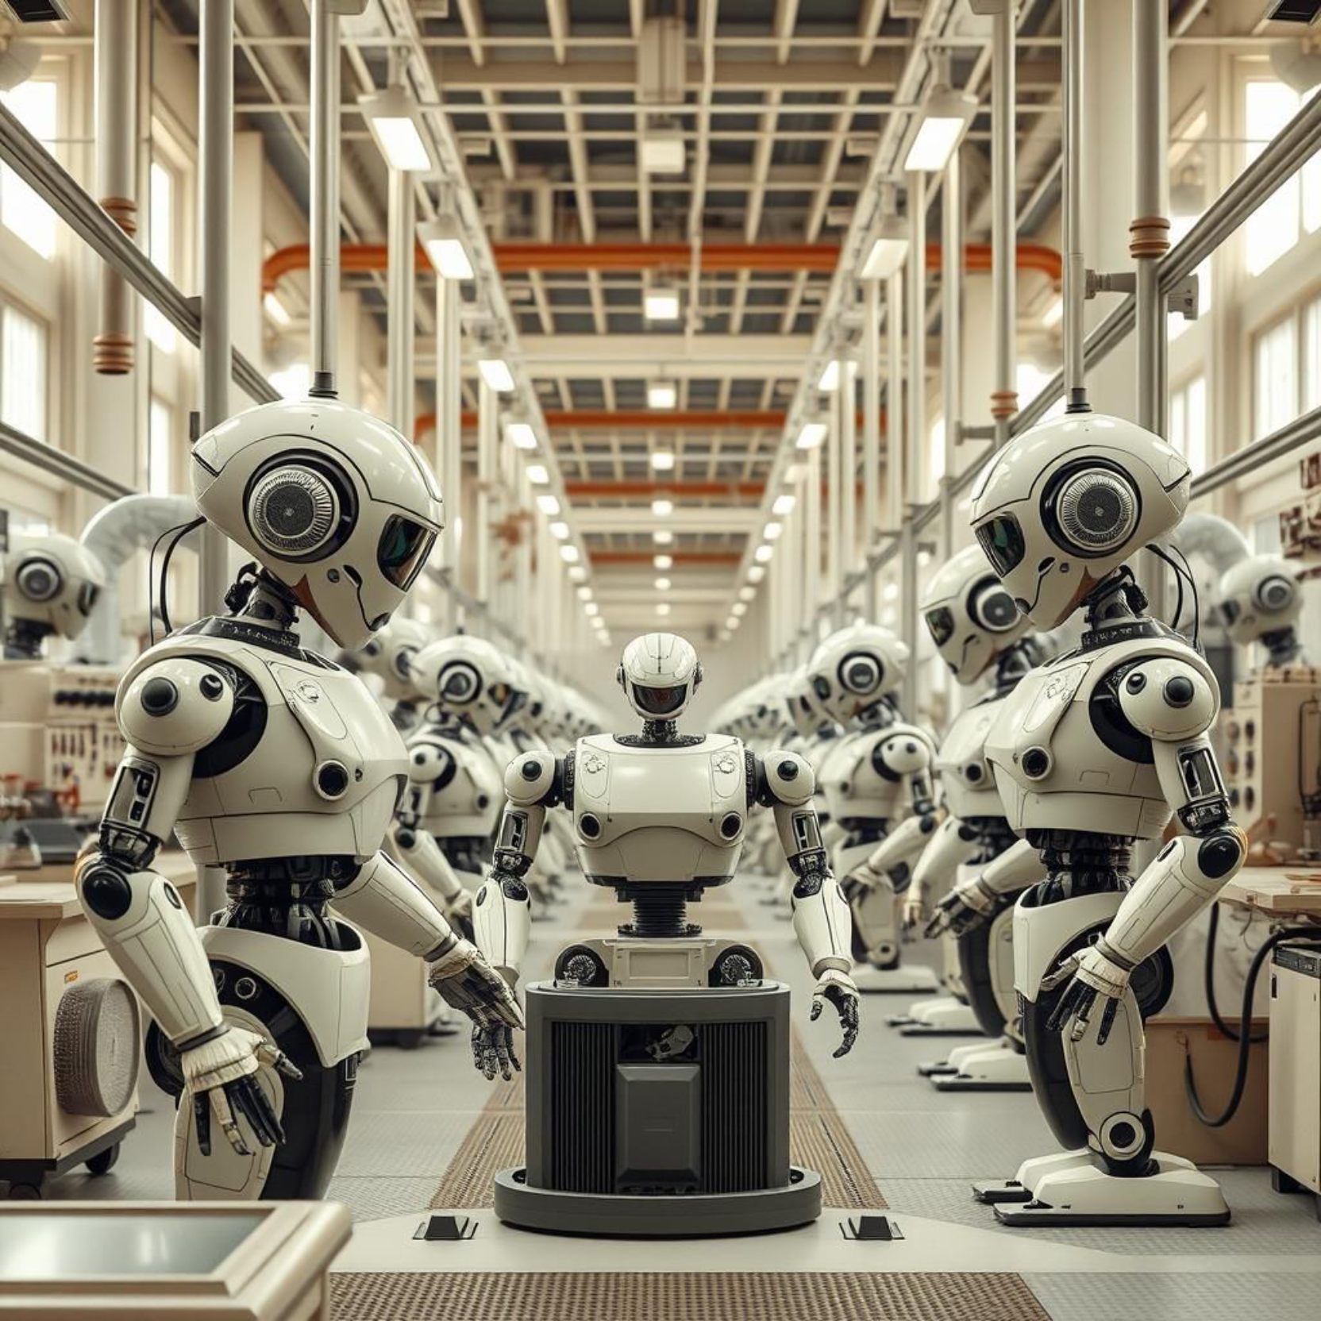
Major Achievements in AI
1. AlphaGo by DeepMind defeated world Go champion Lee Sedol in 2016, showcasing advanced strategic thinking.
2. GPT and ChatGPT by OpenAI demonstrated natural language understanding and generation, revolutionizing communication.
3. AI systems like IBM Watson and Google Health can diagnose diseases more accurately than human doctors in some cases.
4. Tesla, Waymo, and other companies have successfully developed autonomous vehicles that operate with minimal human intervention.
5. DeepMind’s AlphaFold solved the 50-year-old protein folding problem, accelerating drug discovery and biological research.

Slide 9
Biggest Problems Yet to be Solved by AI
Despite progress, major global issues remain unsolved. AI can offer solutions if developed and applied correctly:
1. Climate Change: AI can model climate patterns, optimize energy usage, and suggest policy actions.
2. Cancer Cure: AI is being used to analyze genetic data and design personalized treatments, but a universal cure remains elusive.
3. Food Insecurity: AI drones and sensors can optimize crop yields, detect disease early, and reduce waste.
4. Mental Health: AI-powered therapy bots are being developed, but lack emotional depth and cultural understanding.
The key challenge is integrating AI solutions with human systems and addressing ethical concerns.

Slide 10
Limitations and Challenges of AI
1. Bias: AI systems can reflect and amplify societal biases if trained on biased data.
2. Privacy: Massive data collection for AI raises concerns about surveillance and misuse.
3. General Intelligence: Current AI lacks true understanding, context, and emotion.
4. Energy Use: Training large AI models consumes vast energy (e.g., GPT-4's training cost millions in energy).
5. Ethics: AI in military, facial recognition, or predictive policing raises significant moral questions.
Solving these requires global cooperation, better algorithms, and strict governance frameworks.

Slide 11
Sectors Needing AI Development
1. Education: Personalized AI tutors can revolutionize learning in rural areas, but adoption is low.
2. Disaster Management: AI can predict natural disasters like earthquakes and tsunamis with early warnings.
3. Rural Healthcare: AI diagnostic tools can bridge doctor shortages in remote areas.
4. Waste Management: Smart sorting robots and AI recycling analysis are underutilized.
5. Legal System: AI can help process court backlogs and suggest legal precedents.
These areas remain underdeveloped, especially in low-income regions, due to lack of funding and awareness.

Slide 12
Hardware Requirements for AI
AI hardware (for students/startups):
- Raspberry Pi with Coral USB Accelerator: Enables running light AI models locally.
- NVIDIA Jetson Nano: Ideal for robotics and real-time edge AI processing.
- Arduino + ML modules: For basic pattern recognition and control systems.
Large-scale AI hardware:
- NVIDIA A100 GPUs: High-performance GPUs for training and inference of massive AI models.
- Google TPUs (Tensor Processing Units): Custom hardware for deep learning.
- AI Supercomputers (e.g., IBM Watson, Fugaku): Used in climate science, genomics, and high-end simulations.

Slide 13
The Future of AI
1. Human-AI Collaboration: AI will work alongside doctors, teachers, and engineers to improve outcomes.
2. Creative AI: Tools like DALL·E and GPT can generate art, music, and writing—enhancing human creativity.
3. Explainable AI (XAI): Future systems will be transparent and interpretable for better trust.
4. Ethical AI: Global standards will emerge to govern how AI is developed and used.
The future of AI depends on how responsibly it is built and integrated into human society.

Slide 14
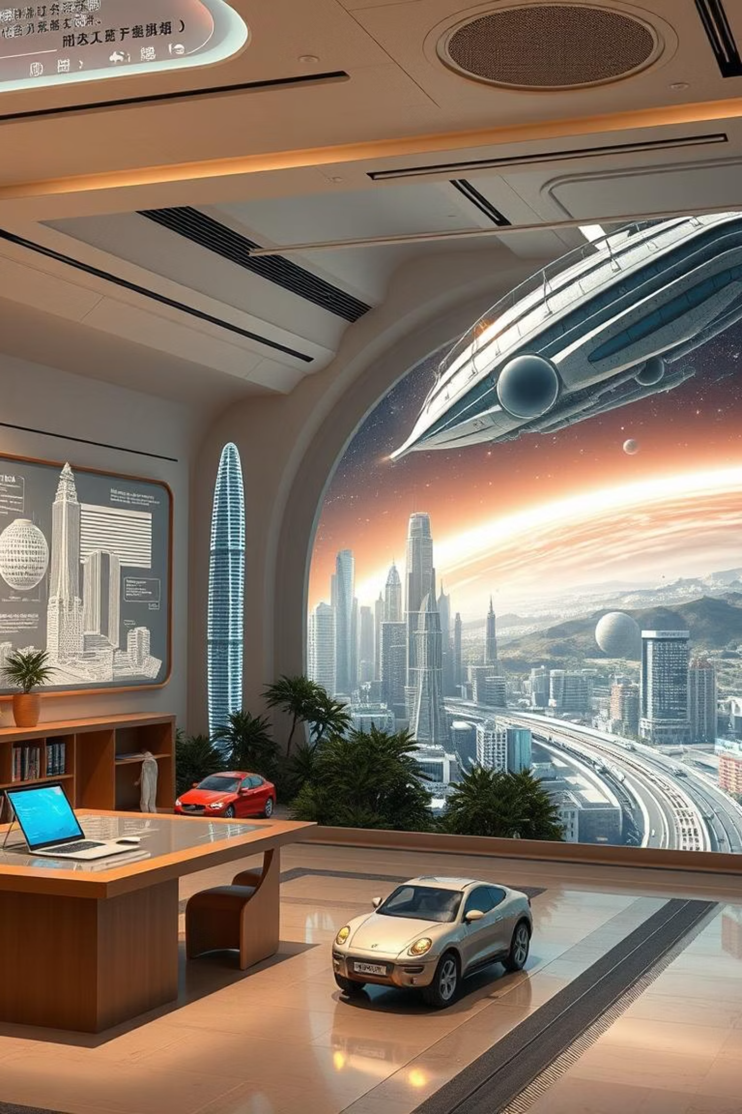
Conclusion & Questions
Artificial Intelligence is already transforming our world—from healthcare to education, from business to space.
It has the potential to solve some of humanity's toughest challenges, but it also brings new risks. With responsible development, AI can be a powerful force for good.
Thank you for your attention. I’d be happy to answer any questions you have.

